Slide 1
Weekly Research Update
Rushik Sriramoju | July 24th 2026
1 · LAST WEEK'S GOALS
3 · WHAT WORKED / DID NOT WORK
Create a heatmap to compare the values of morphological features between cell lines.
Create a heatmap to compare the values of morphological features between cell types.
Making heatmaps with column clustering worked quite well. However, some formatting needs to be improved.
2 · WHAT I ACHIEVED
The particular morphological features that are significantly different among the cell lines and cell types have been visualised using the heatmap.
4 · PLAN FOR NEXT WEEK
Compare between Control vs Each variant and compare within the cell lines within each cell type.
Find out more about the biological meaning of this.
Notes:
WEEKLY SUMMARY — one per week.
How to use: each week, duplicate this slide plus your results slides and move the copies to the FRONT of the deck. Older weeks stay below the 'Previous Weekly Updates' divider.
Keep to three goals. Set each status chip to Completed / Partly completed / Not completed. Fill the feedback box every week — if there is no question, say what decision you are assuming.

Slide 2
Lab 2 Heatmaps

Slide 3
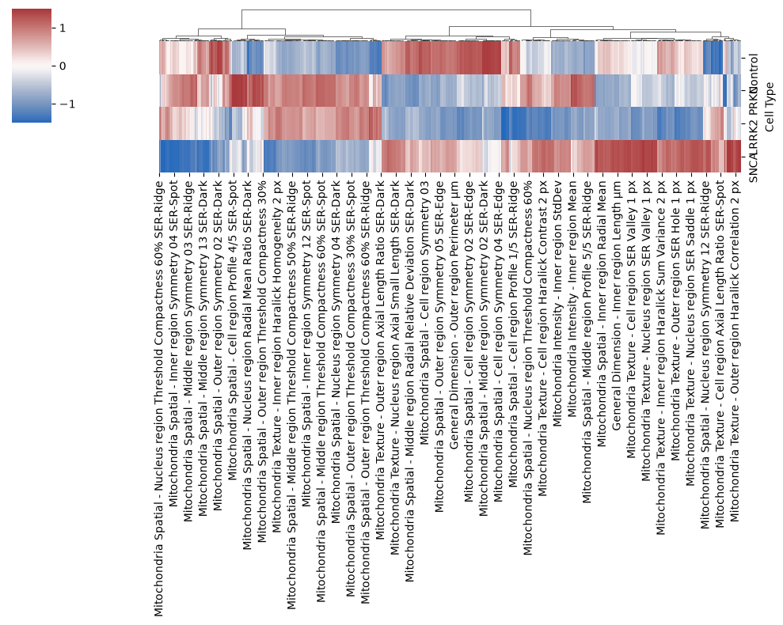
Results: Comparison between Cell Types
Rushik Sriramoju | July 24th 2026

Slide 4
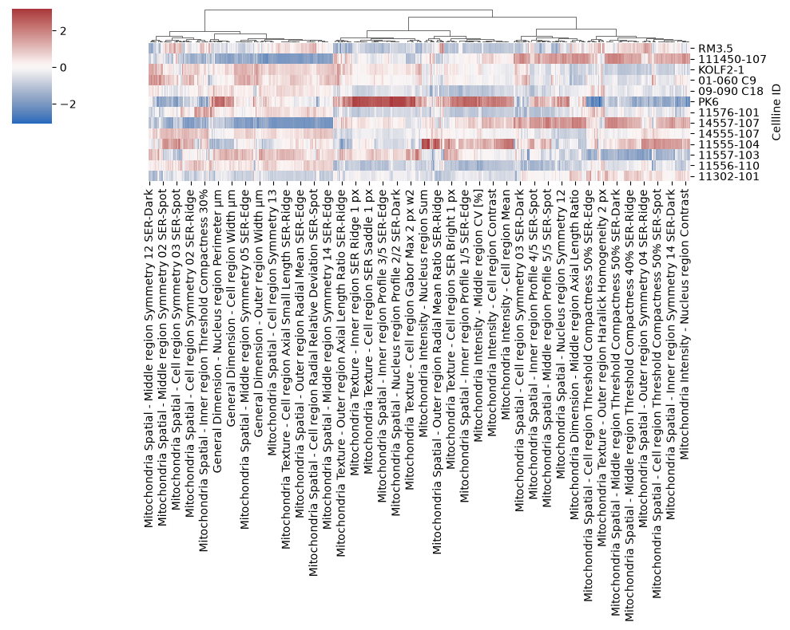
Results: Comparison between Cell Lines
Rushik Sriramoju | July 24th 2026

Slide 5
Lab 1 Heatmaps

Slide 6
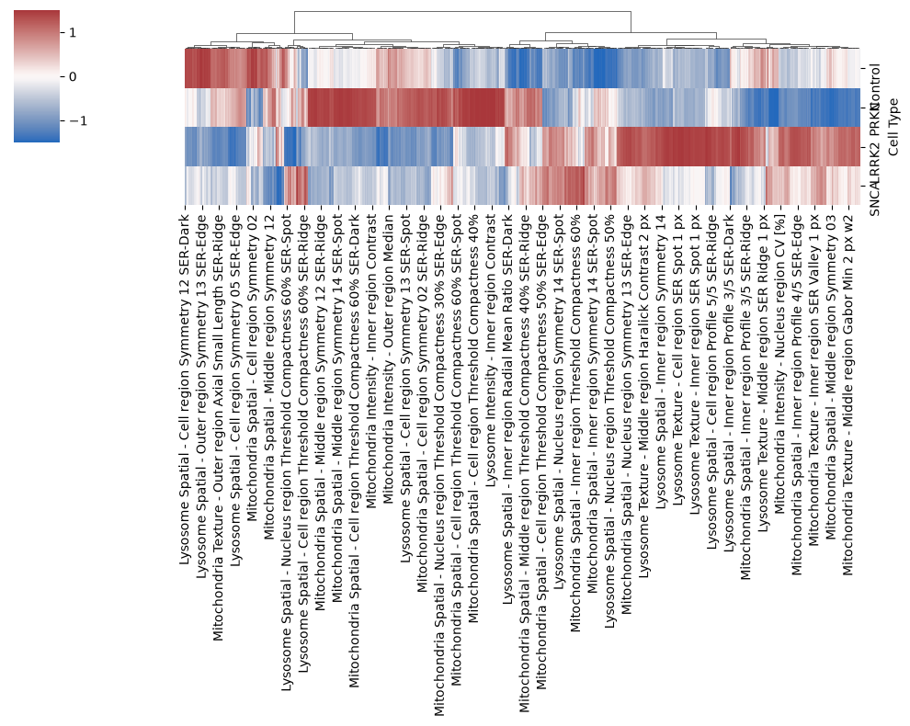
Results: Comparison between Cell Types
Rushik Sriramoju | July 24th 2026

Slide 7
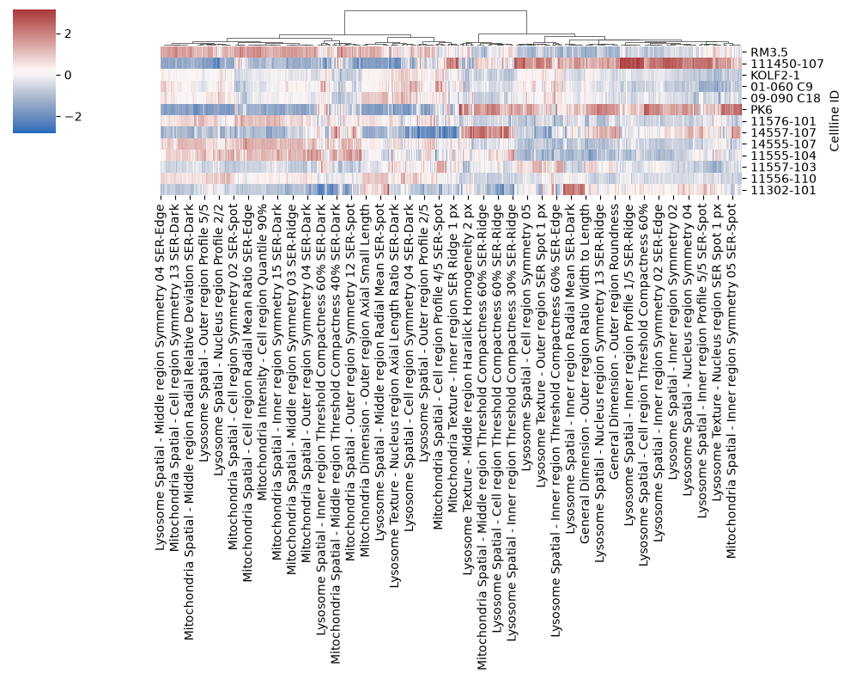
Results: Comparison between Cell Lines
Rushik Sriramoju | July 24th 2026

Slide 8
Lab 1 Heatmaps - Row Clustering True

Slide 9
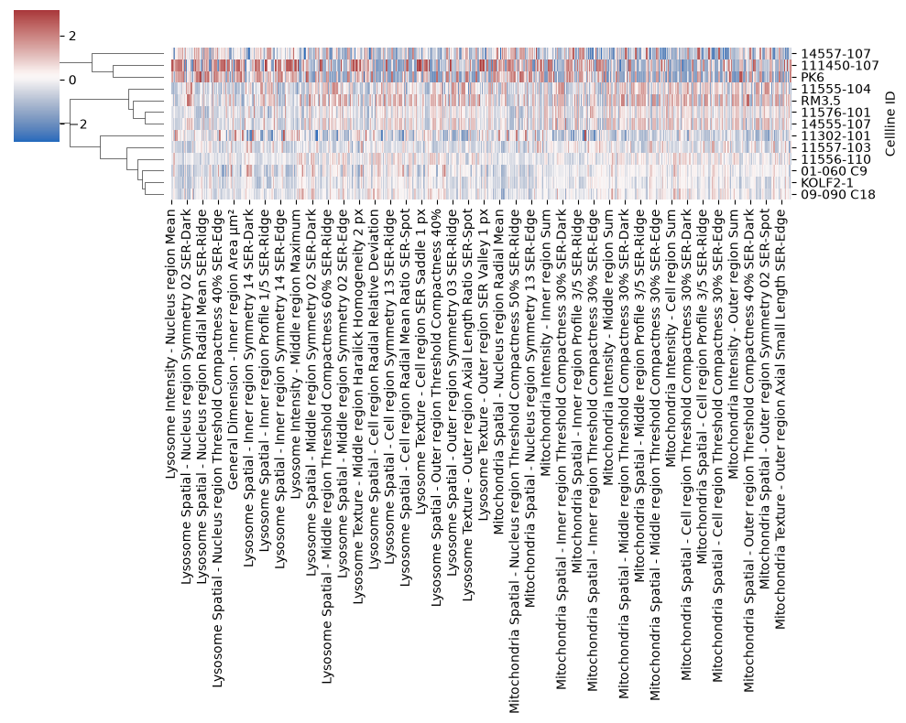
Results: Comparison between Cell Lines
Rushik Sriramoju | July 24th 2026
¾ control lines do actually cluster together.

